Slide 1
Open Forums
December 10th, 2019
Davis-Shaughnessy, Room 173
1:30 – 2:30pm
December 11th, 2019
Allied Health Bldg., 3rd Floor, Multi-Purpose Room
3:00 – 4:00pm

Slide 2

Agenda
Value and Mission
        - David Hakanson
Program Status Phase 1 & 2
- Jackie Manikam
Go Live Support Strategy
- Mickey Luna
Finance Customer Confirmation Sessions Feedback
- Brianne Burcke (North Campus)
        - Patty Klingelhoefer (South Campus)

Slide 3
Value and Mission

Slide 4
Reasons For Move To Workday
Optimize and improve business processes
System limitations
Lack of effective data reporting
Old technology platform
End user experience

Slide 5
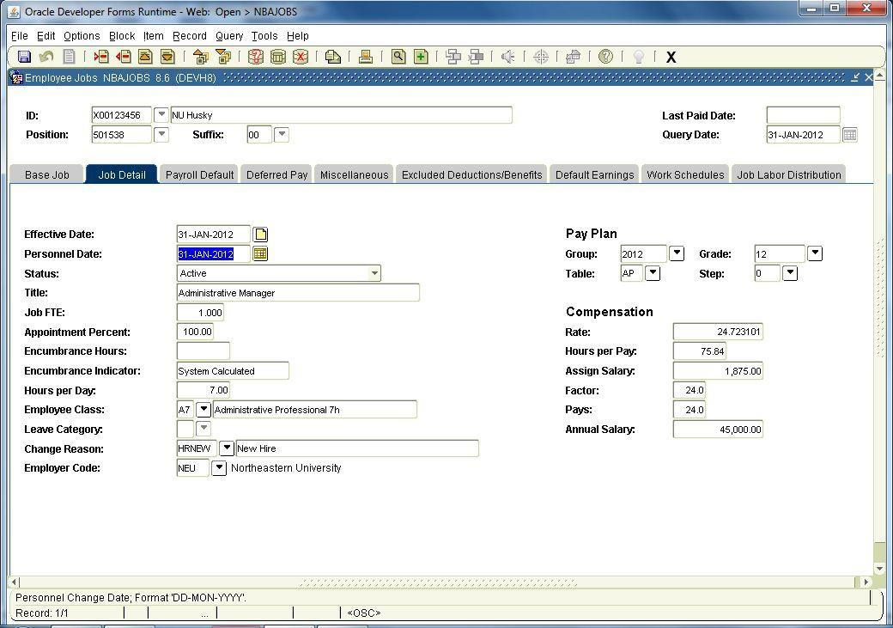
Banner – A Legacy System

Slide 6
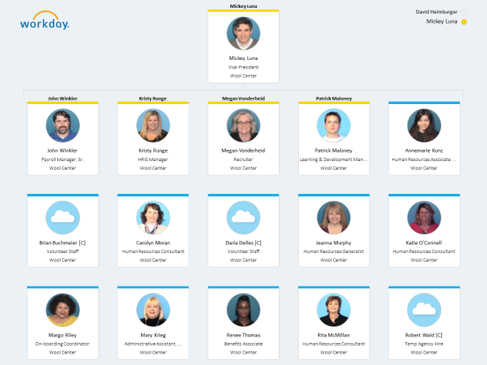
Workday – A Modern System

Slide 7
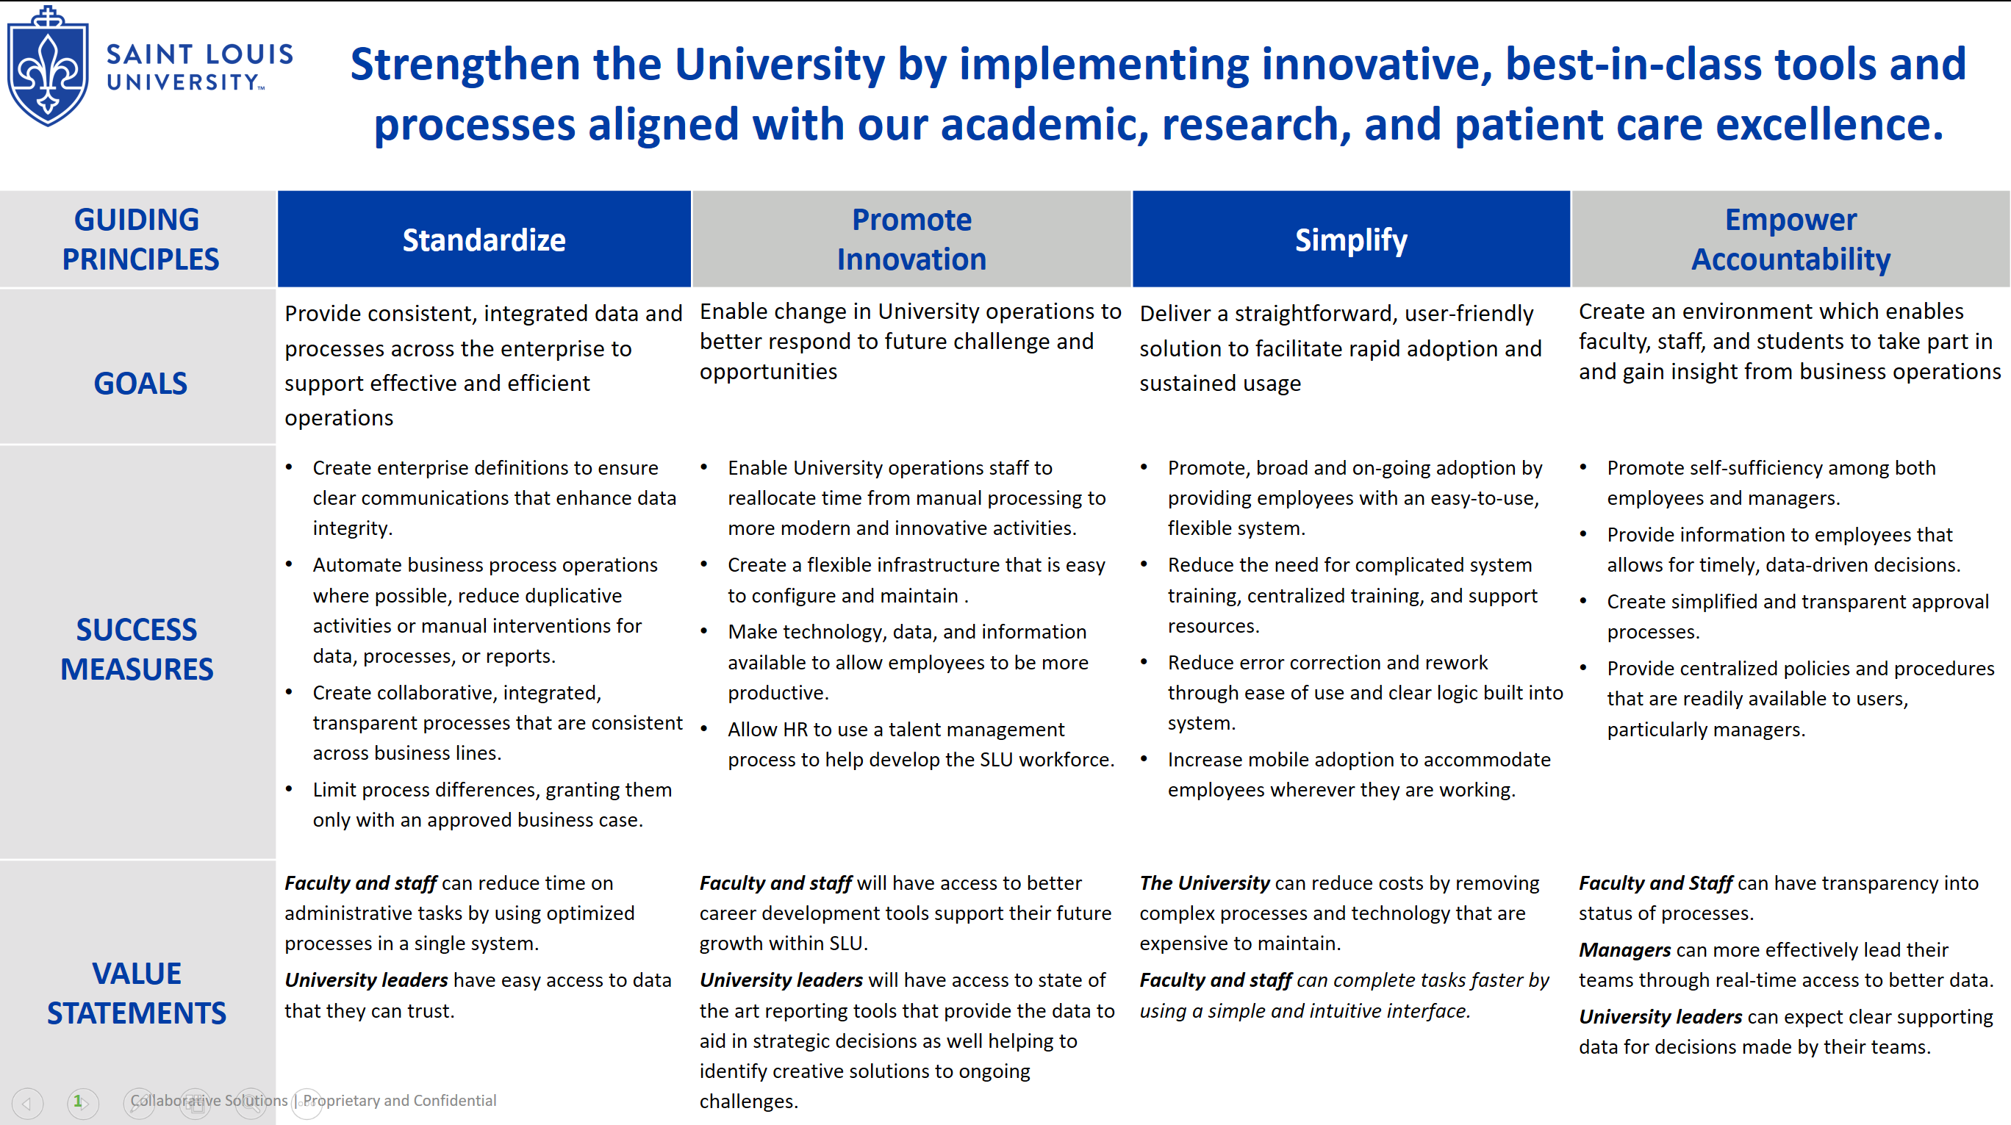
Workday Organizational Charts

Slide 8
Program Status

Slide 9
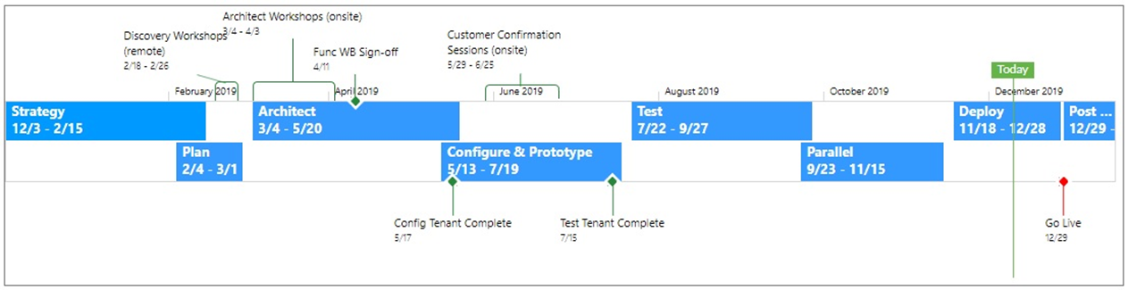
Phase 1 Project Status
Phase 1: HCM Project Timeline

Slide 10
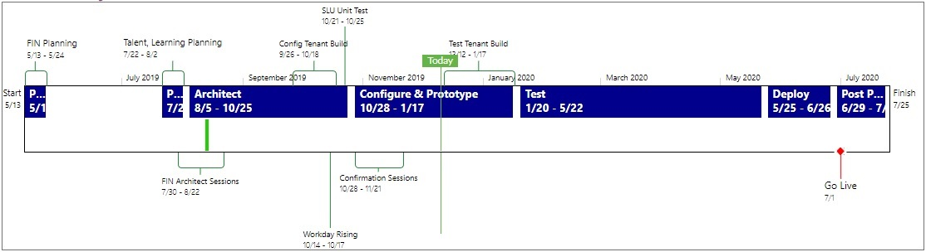

Phase 2 Project Status
Phase 2: Finance & Talent / Learning Project Timeline

Slide 11
Go-Live Support Strategy

Slide 12
Training
Videos Published in HR Bulletin
Webinars/In-Person Training
This week
  General Navigation
  Time Tracking
Next week
  Performance Evaluations
Coming in January
  Compensation
  Performance
  Recruiting

Slide 13
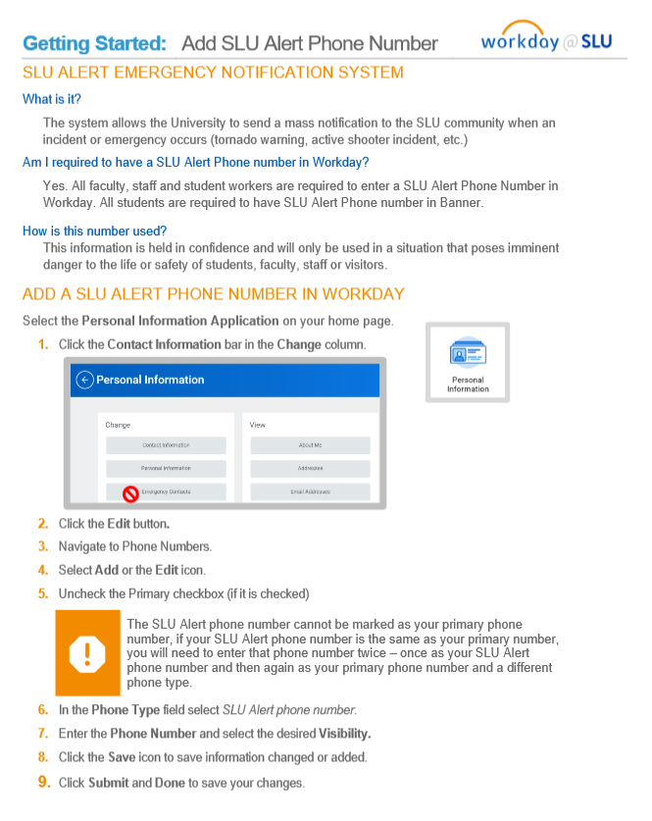
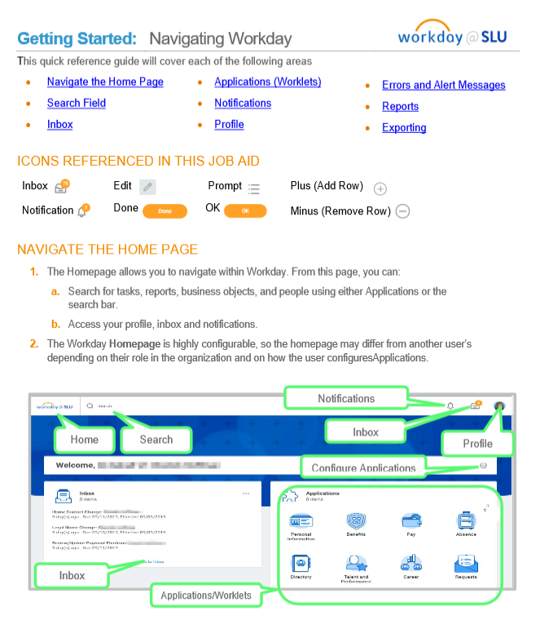

Material Support
Job Aids
Short Videos

Slide 14
Phone Support
Help Desk
Dedicated Call Center
24x 7x 365 support
(314) 977-4000
Jan 2 – Jan 17
9am – 4pm
(314) 977-4000
  Select option for Workday

Slide 15
In-Person Support
South Campus
North Campus
LRC Atrium
Jan 2 – Jan 10
9am – 4pm
Wool 128
Jan 2 – Jan 17
9am – 4pm

Slide 16
Finance Customer Confirmation Sessions Feedback

Slide 17
Changes Coming in Workday Finance
Department deposits done in Workday directly not Touchnet.
Budget amendments no longer submitted via paper, but directly in Workday by the business or cost center managers and approved electronically by the Budget Office.
Budget will be entered at the spend or revenue category level not the individual account level (for instance Travel not meals, hotels, etc.).
Over 40 University departments will be transitioning from decentralized billing to Workday Customer Accounts. SLUCare patient billing, CADE and student accounts will still be maintained in their own system.
Customer contracts can be maintained in Workday vs. maintaining in EXCEL.
Ability to invoice in Workday will significantly reduce creation of manual invoices and related journal entries.

Slide 18
Changes Coming in Workday Finance
Aging reports in Workday will create improved opportunity to manage SLUCare receivables.
Departments can view market values of their endowments in Workday.
Journal approval first by supervisor with final approval by accounting leads in Business and Finance or Med Center accounting (Greg Haney, Karen Wamhoff or Beth Simon.)
Spreadsheet format designed for journal entry uploads.
Ability to run reports through use of Worktags offers flexibility and more real time data
Cost center PO or Requisition approvers can be delegated by the user or the BP administration when out of office.
Departments can create their own Projects (approved by accounting administration).

Slide 19
Finance Workstream Leads

